Slide 1


ETTG - Practitioners’ Network
Making development finance more impactful:
Advancing complementarity between European donors, implementing agencies and DFIs/PDBs
Key insights and recommendations
21 September 2022
This ETTG project is conducted for the
Practitioners’ Network for European
Development Cooperation

Slide 2
Agenda
Background
Main outcomes
Provide an overview of the key insights of the study
Discuss the results and broader implications of the findings
Identify additional ways to strengthen coordination
2. Coordination: objectives and challenges
3. Lessons learnt and recommendations

Slide 3

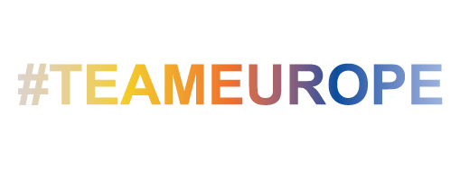



Introduction
Growing importance of development finance as a way to mobilise resources and catalyse private sector initiatives and finance
Recognition that European architecture for development requires:
better and more systemic coordination and cooperation,
on blended finance and beyond,
to catalyse private and public initiatives and finance at scale and for greater impact.
Too often, European donor governments and their development agencies operate in parallel with their financial institutions for development or rely on standalone operations.
But there are several interesting examples of successful collaboration.
=> how coordination between the roles and activities of European donors, implementing agencies and DFIs/PDBs can best be incentivised, articulated and implemented in practice.
Draw lessons from practice on 1) coordination framework, 2) challenges, 3) success factors, and propose some recommendations
8 case studies: EIB, EBRD, France, Germany, Italy, the Netherlands, Spain, and the UK, with specific examples

Slide 4
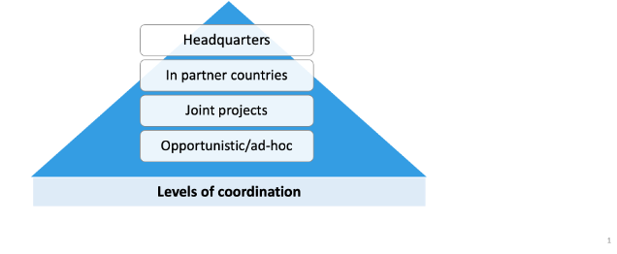



Coordination: nature and objectives
Coordination between donors, implementing agencies and DFIs/PDBs takes place at multiple levels, shaped by the institutional framework in which donors, implementing agencies and DFIs operate.
Providing donors, implementing agencies and DFIs/PDBs access to complementary resources and tools, notably by: optimising the use of technical assistance; de-risking public and private investments and pooling together a unique set of knowledge, expertise and resources
Paving the way for a more comprehensive and synergistic approach by adopting a comprehensive approach to investment; linking projects and shifting from project to systemic impacts; enabling ‘escalator’ or ’cascading’ engagement to shape markets
Offer a platform for addressing common issues together, by developing a pipeline of bankable projects; ensuring solid impact reporting and enabling DFIs/PDBs to be responsive in times of crisis

Slide 5
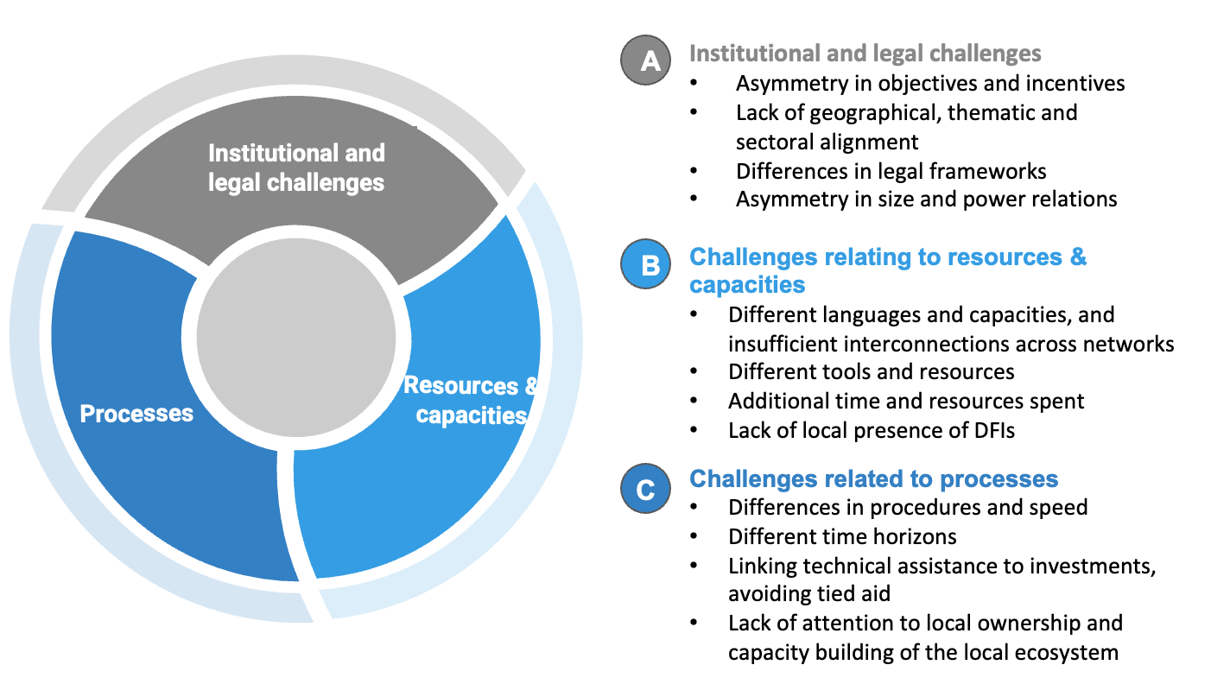
Coordination: Challenges

Slide 6
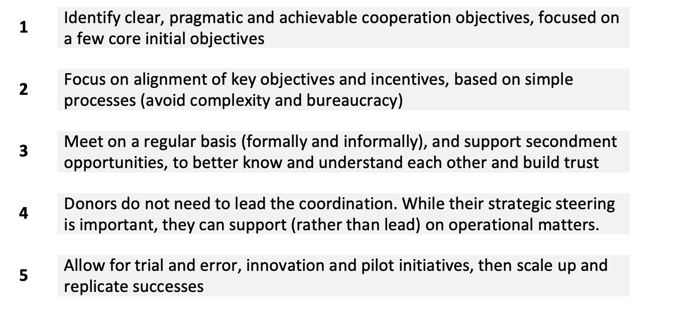
Lessons learnt and recommendations

Slide 7
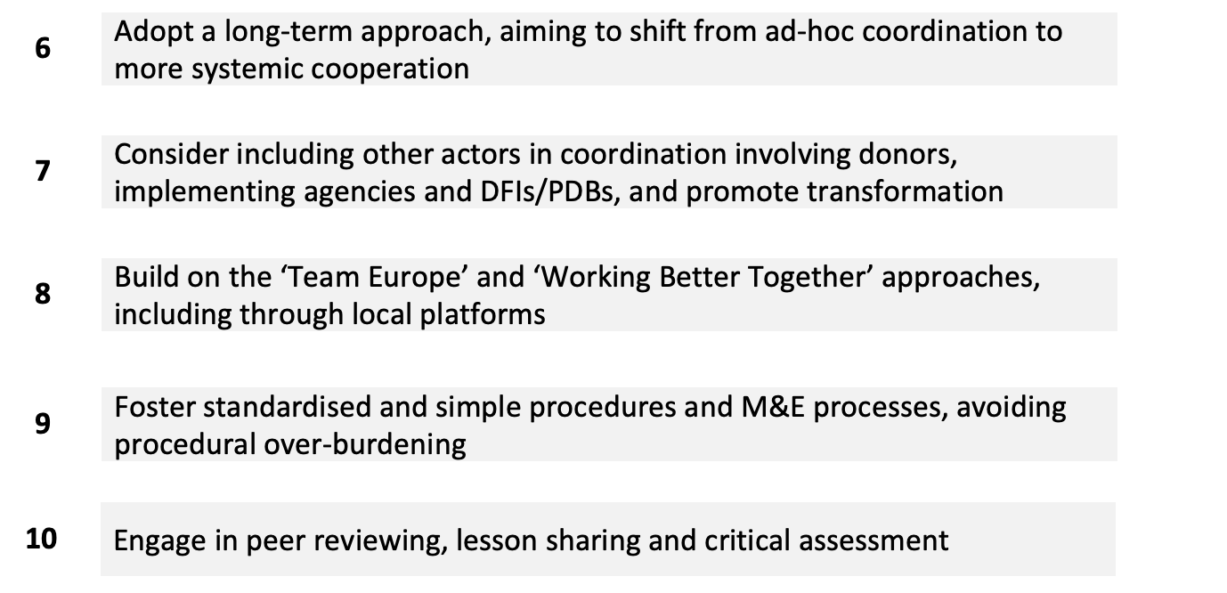
Lessons learnt and recommendations

Slide 8


Thank you very much!
San Bilal and Karim Karaki (ECDPM)
with contributions by
Elise Dufief (IDDRI), Niels Keijzer (IDOS), Iliana Olivié and María Santillán O’Shea (Elcano)
www.ettg.eu
@ettg_eu

